Slide 1

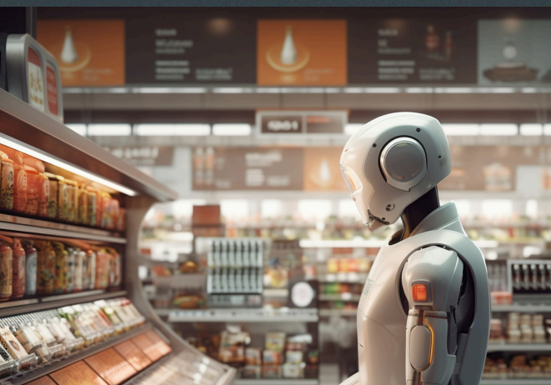
Computer Science Capstone Project
Team Name: TEAM MISSION POSSIBLE
(deadly by name & game)
Team 4

Slide 2
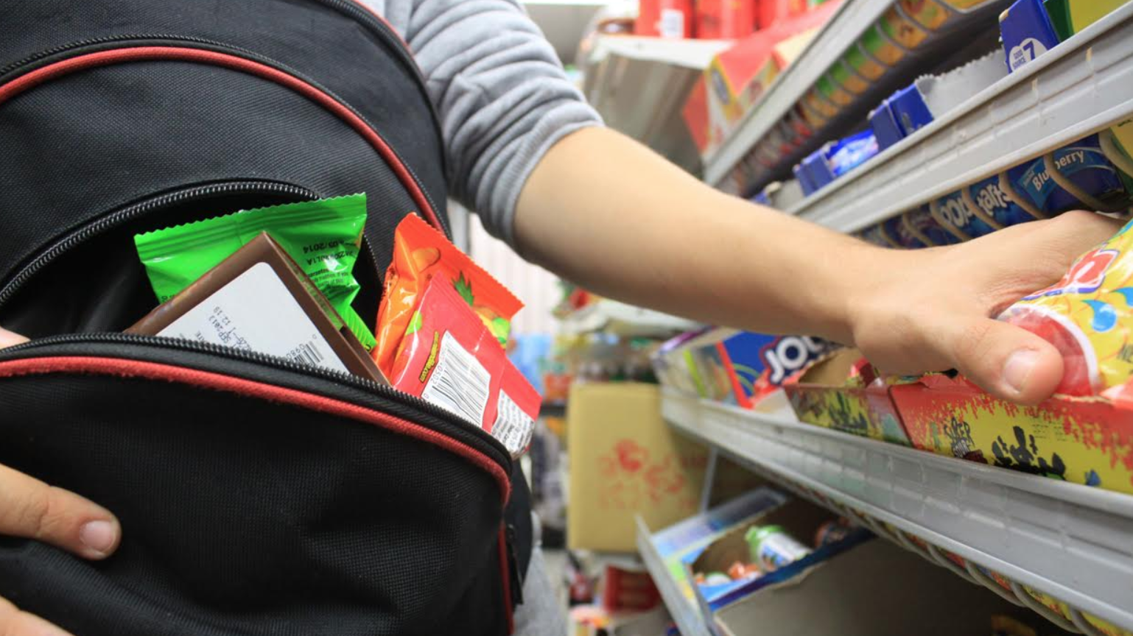
Theft Alert

Slide 3

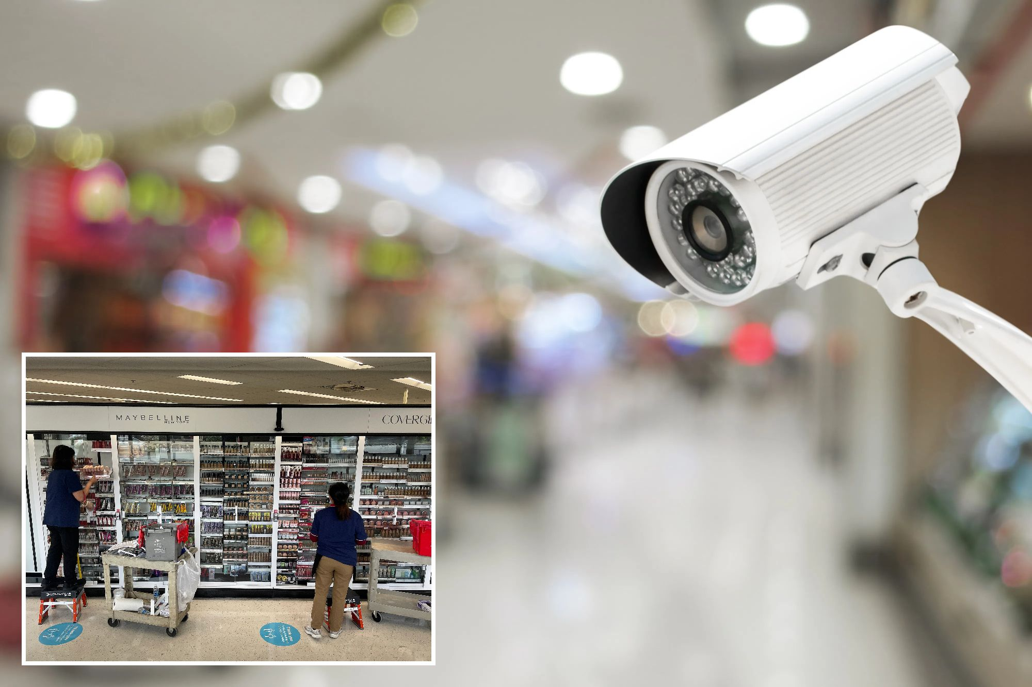

Team Member Roles and Responsibilities
Improvements
made from Professor Feedback
Project Statement
Project Description
Team Working Agreement
Personas
Minimal Viable
Product (MVP)
Technologies
Architecture Diagrams
Product
Backlog
Sprint 1
Backlog
Metrics
Retrospective
Sprint 2
Backlog
App Logo
Project Demo
GitHub Link
Live Application Demo

Slide 4
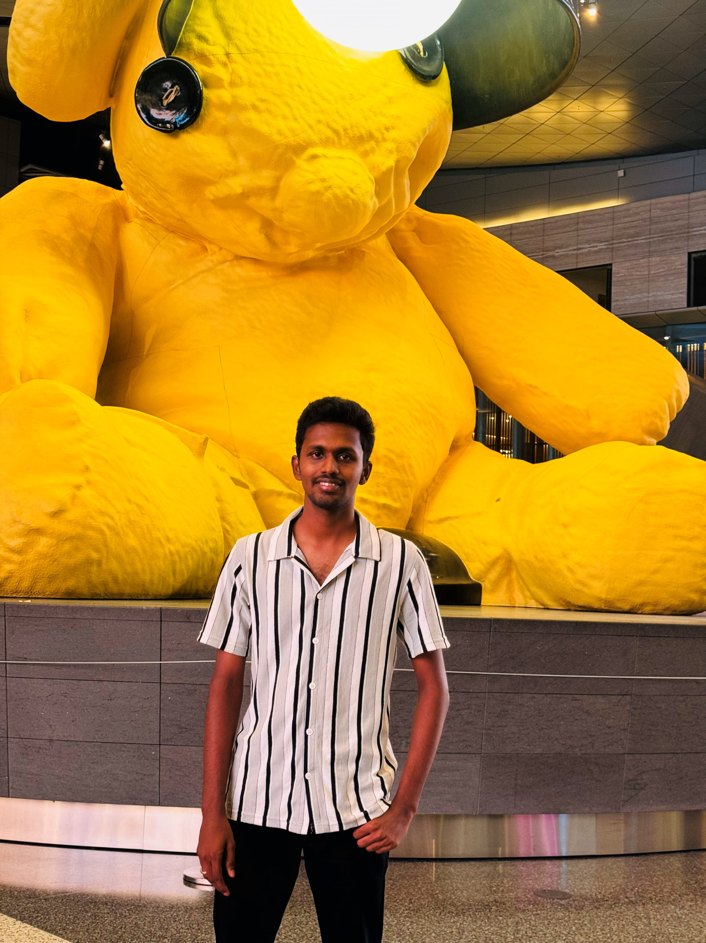
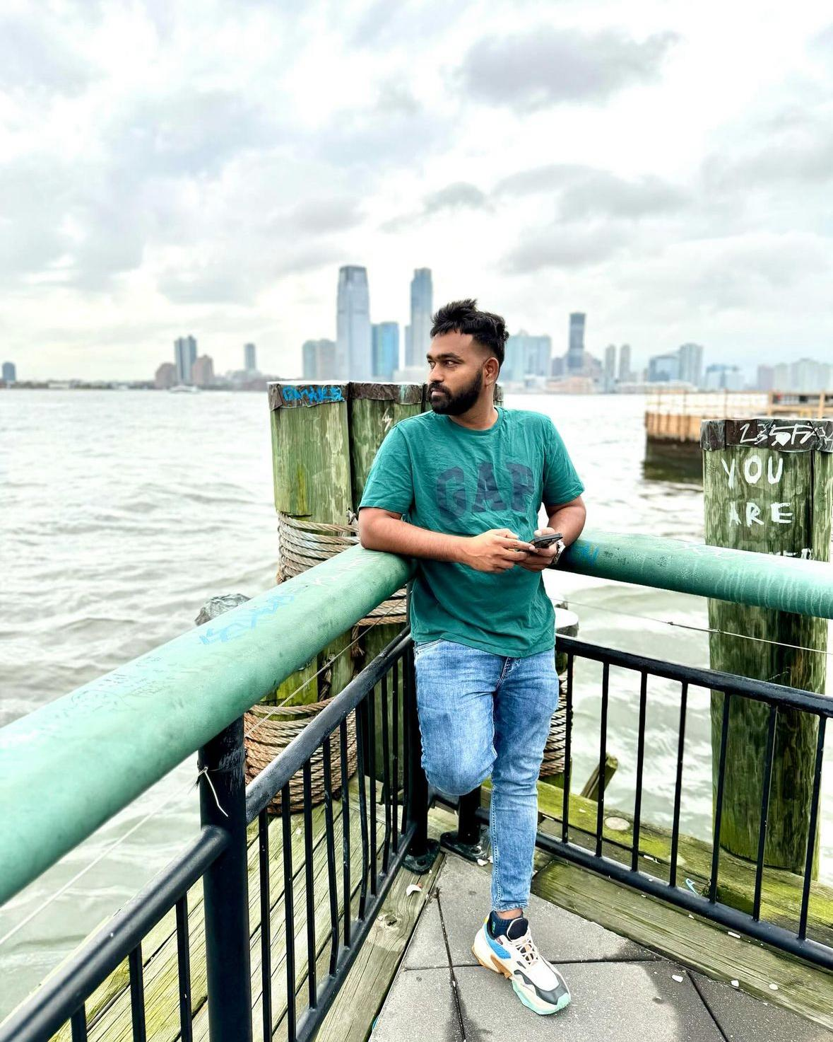
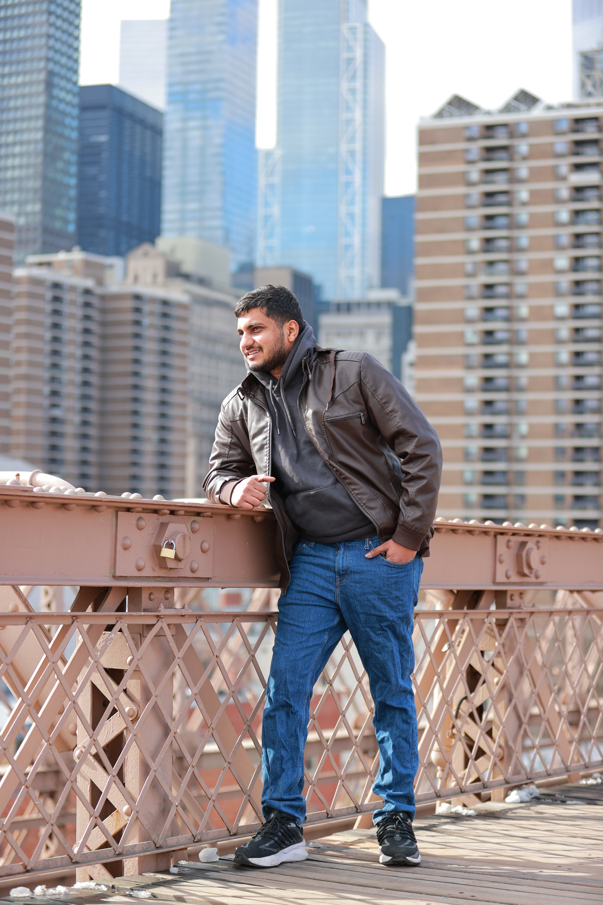
TEAM MEMBER ROLES
Shiva
Data Scientist
Prudhvi
Full Stack Developer
Vinod
Data Analyst & Product Developer

Slide 5
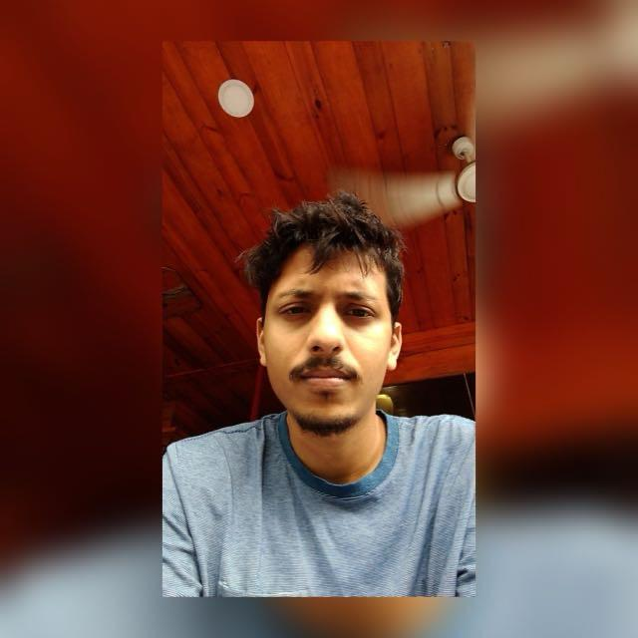

TEAM MEMBER ROLES
Mayank
Artificial Intelligence Engineer & Project Manager
Vishnu Raju
Software Developer

Slide 6

Improvements made from Feedback Professor
Change the project description to match the syllabus.
The PowerPoint presentation must also include a link to GitHub.
Adjust the sprint schedule per the syllabus.
Don't be late to sprint 1 like sprint 0; be on time.
Change the personas as per the syllabus.
Change tools and technologies as needed.

Slide 7

PROJECT STATEMENT
Shoplifting is a significant problem for supermarkets, leading to financial losses and higher customer prices. Current security methods often react to theft after it has already happened, which is ineffective. There is a clear need for a better solution that can prevent theft before it occurs. Our project aims to develop a Supermarket Theft Detection System that uses advanced technology to monitor customer behavior in real time, including computer vision and machine learning. This system will help identify suspicious activities and alert security personnel immediately, allowing them to respond quickly and reduce theft incidents. By analyzing data on theft patterns, supermarket managers can also make informed decisions to enhance security and improve the shopping experience for all customers.

Slide 8
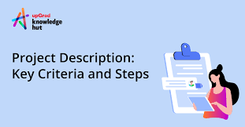
PROJECT DESCRIPTION
Project Name: | Theft Alert
Team: | TEAM MISSION POSSIBLE (deadly by name & game)
Project Description: | The Supermarket Theft Detection System uses existing CCTV cameras and machine learning to proactively monitor customer behavior, detect suspicious activities, and alert security personnel, significantly enhancing store safety and reducing theft losses.. For retail stores who struggle with shoplifting, the Supermarket Theft Detection System is a proactive solution that leverages existing CCTV cameras and machine learning that monitor customer behavior in real time and alert security personnel. Unlike traditional reactive security measures, our application detects suspicious activities before theft occurs, significantly reducing losses and enhancing store safety.
Benefit Outcomes: | Minimizes financial losses from shoplifting. Enables quick responses from security personnel with real-time alerts. Fosters a safer shopping environment for honest customers. Provides valuable analytics on theft patterns for informed decision-making. Adaptable for implementation across multiple store locations. Works with existing security infrastructure for a smooth transition. Allows for upgrades, such as improved facial recognition and behavior prediction. Combines technology and human oversight for effective theft prevention.
Github Link: | https://github.com/htmw/2024F-Team4/wiki

Slide 9

PROJECT DESCRIPTION
Shoplifting poses a significant challenge for retail stores, leading to financial losses and increased prices for consumers. Traditional security measures are largely reactive, addressing theft only after it occurs. Our project aims to develop a Supermarket Theft Detection System that utilizes existing CCTV cameras and machine learning to monitor customer behavior in real-time. The system will analyze video footage for unusual movements and automatically alert security personnel to potential theft, enabling quick responses. This proactive approach not only reduces theft losses but also enhances the shopping experience by fostering a safer environment. Additionally, the system is scalable for multiple locations and integrates seamlessly with current security infrastructure. By providing valuable insights into theft patterns, our innovative solution aims to revolutionize supermarket security and improve overall safety for customers and staff.

Slide 10

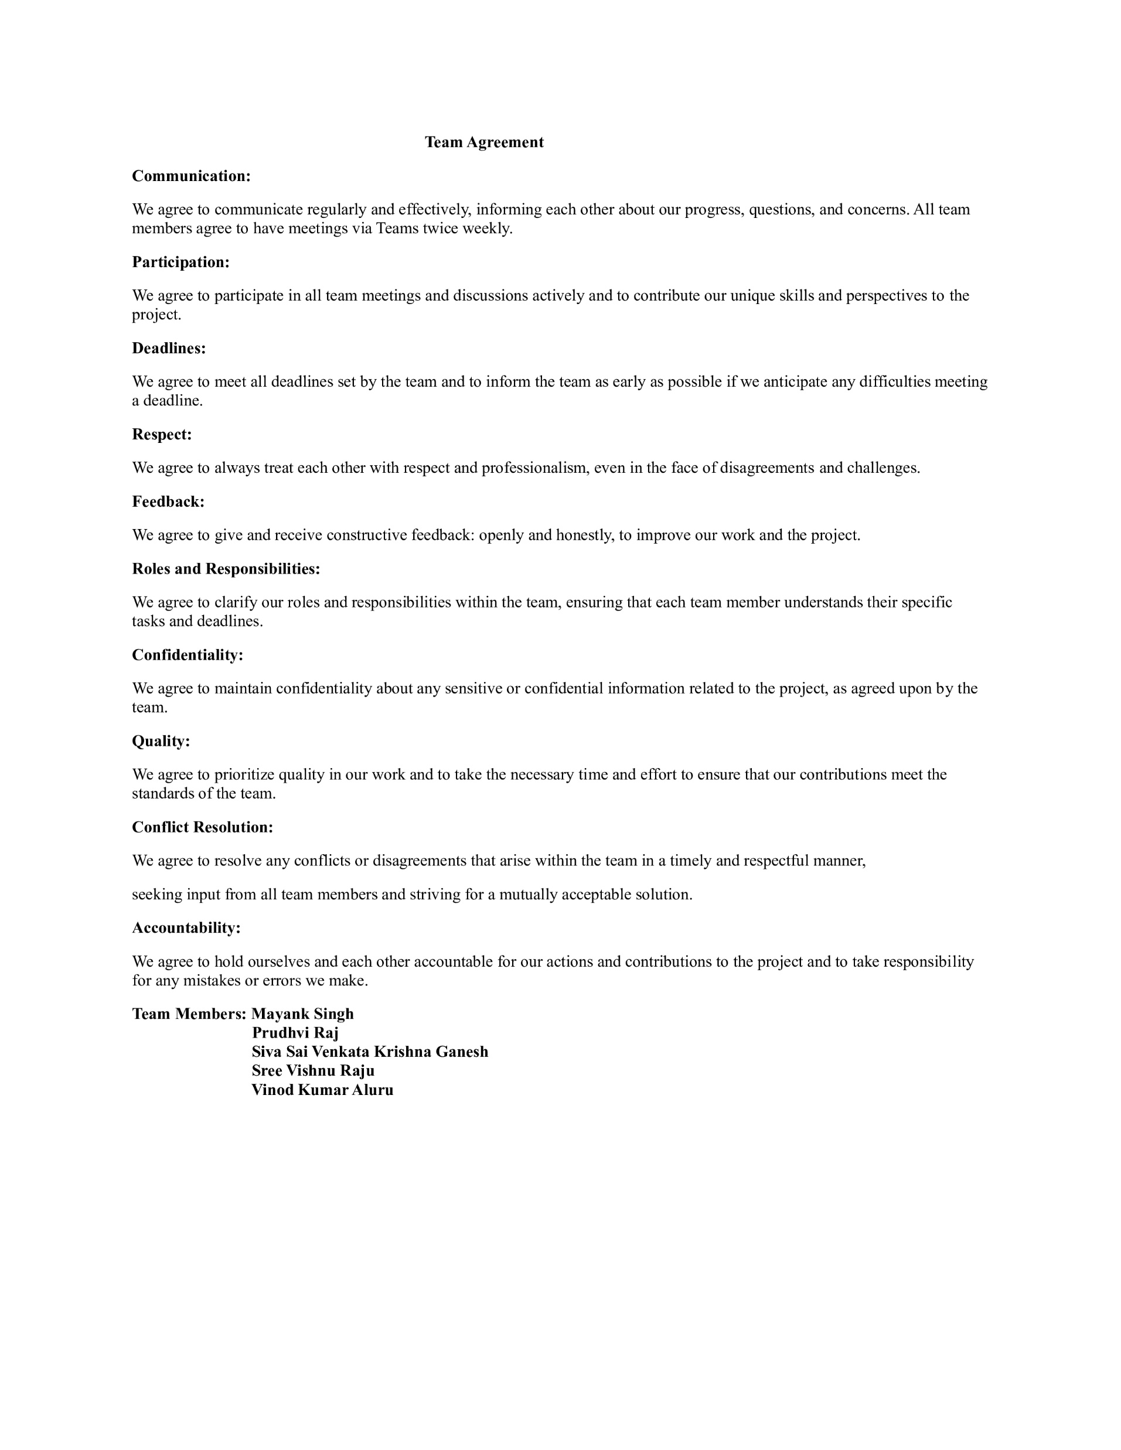
TEAM WORKING AGREEMENT

Slide 11

PERSONAS

Slide 12
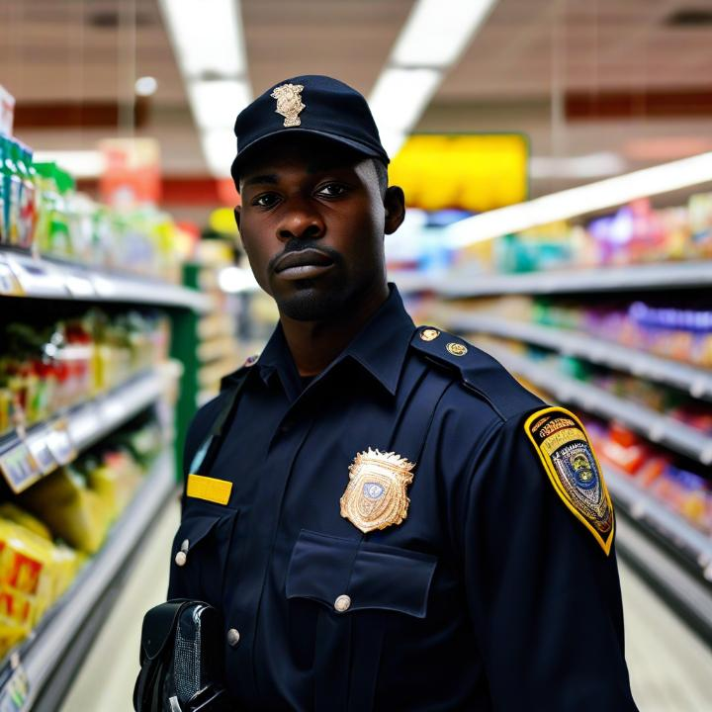
PERSONA - 1
Profile
Name: James
Age: 30
Location: Alabama, Ga
Job: Chief Security Officer
Salary: $112000/year
Family: wife
James, a dedicated Chief Security Officer, oversees the safety of a large retail complex, drawing on years of experience to identify and mitigate potential threats. He understands that maintaining security requires not just vigilance but also the right tools to respond effectively to incidents. Faced with the daunting task of monitoring a vast area with limited resources, Officer James is eager to adopt advanced surveillance technology. He seeks a comprehensive system that offers real-time video monitoring, facial recognition, and instant alerts, allowing him to swiftly identify suspicious activities and track individuals. With the ability to review footage and generate detailed reports, he aims to enhance collaboration among his security team, streamline incident investigations, and ultimately foster a safer shopping environment for customers and staff alike.

Slide 13
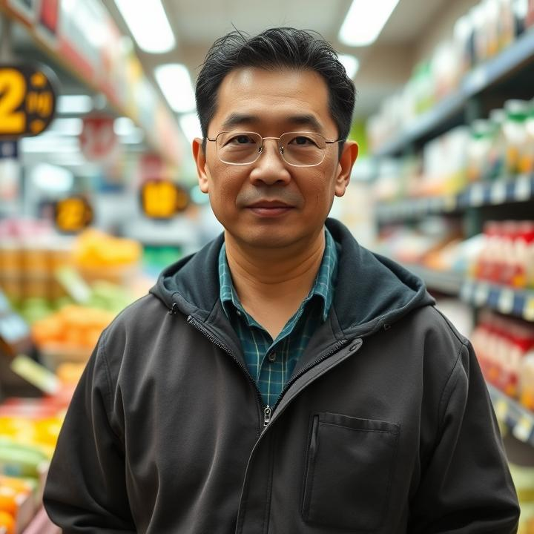
PERSONA - 2
Profile
Name: Mr. Wong
Age: 45
Location: New York, NY
Job: Store Owner
Family: Two children and wife
Mr. Wong is a dedicated convenience store owner managing a bustling shop in a vibrant neighborhood. With a strong commitment to customer safety and satisfaction, he meticulously oversees his store's daily operations. However, as foot traffic and transactions continue to rise, Mr. Wong finds it increasingly challenging to monitor every aspect of his business. He values efficiency and reliability, seeking solutions that allow him to safeguard his store without compromising the quality of service. As he embraces technology, Mr. Wong is eager to implement a comprehensive surveillance system that not only enhances security but also fosters a trustworthy environment for his customers and employees alike.

Slide 14

PERSONA - 3
Profile
Name: Rodriguez
Age: 27
Location: New Jersey, NJ
Job: Supermarket Manager
Salary: $125000/year
Family: Lives with her boyfriend
Ms. Rodriguez is a dedicated supermarket manager, responsible for the bustling operations of a large grocery store. With a keen focus on enhancing customer satisfaction and optimizing operational efficiency, she strives to ensure that every shopper enjoys a seamless experience. However, the constant influx of customers and the dynamic environment make it challenging for her to oversee all aspects of the store effectively. To support her management efforts, Ms. Rodriguez is eager to implement an advanced surveillance system that offers insights into customer behavior through features like people counting, heat mapping, and dwell time analysis. This technology will help her identify bottlenecks, optimize store layouts, and monitor employee activity. By leveraging these tools, she aims to make data-driven decisions that enhance store performance and create a safer, more enjoyable shopping environment for her customers.

Slide 15

MINIMAL VIABLE PRODUCT (MVP)

Slide 16

MINIMAL VIABLE PRODUCT (MVP)
The following are the features we are covering in our MVP:
Welcome Page
Registration Page
Login Page
Main View Videos Page
Manage Videos Page
Upload Videos Page
Setting Page

Slide 17
MINIMAL VIABLE PRODUCT (MVP)
Welcome Page:
The welcome page introduces the application and provides basic information about it. The login/register button appears on the welcome pages.
Registration Page :
The user should be able to click the "register" button after entering their information in the designated fields.
Login Page :
The user should be able to click the login button after entering their credentials.
Main View Videos Page:
The user should be able to access all of the application's functionality from the Main View Videos Page. Mainly it shows the available CCTV videos with live video footage and records video footage.

Slide 18
MINIMAL VIABLE PRODUCT (MVP)
Manage Videos Page :
To edit or remove the uploaded videos, the user should have access to all the Video Names, Uploaded By, and Actions.
Upload Videos Page:
By providing the video name, the user should be able to submit new videos using the file upload button.
Setting Page:
This area allows users to change their profiles and provide feedback on the application to the admin team.

Slide 19


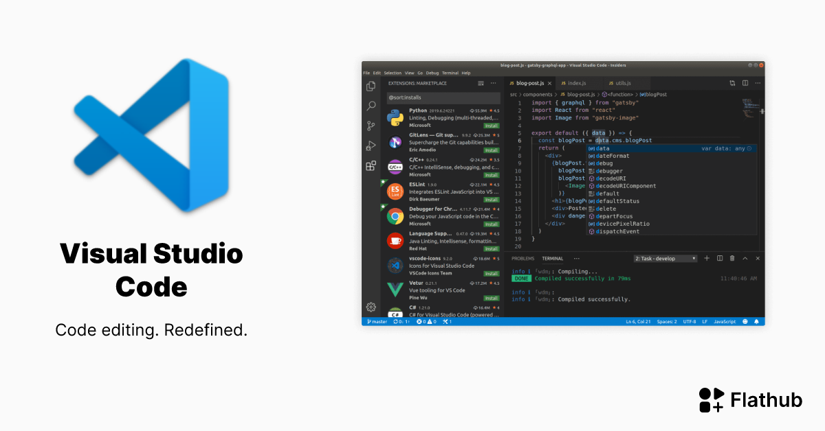


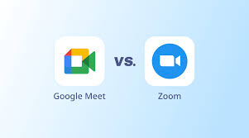






TECHNOLOGIES
Programming languages, Frameworks/Libraries
Database
Tools

Slide 20


ARCHITECTURE DIAGRAM

Slide 21
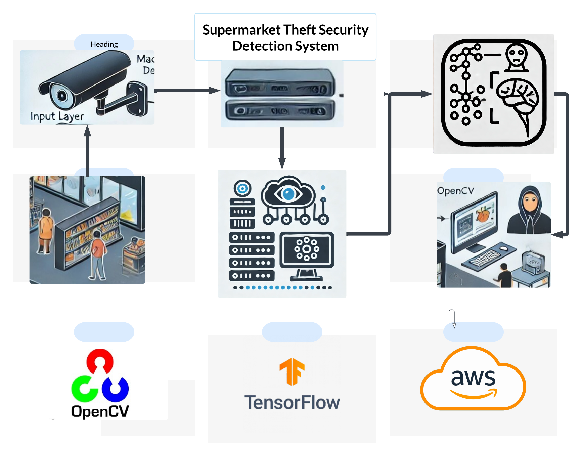

CONCEPTUAL ARCHITECTURE DIAGRAM

Slide 22
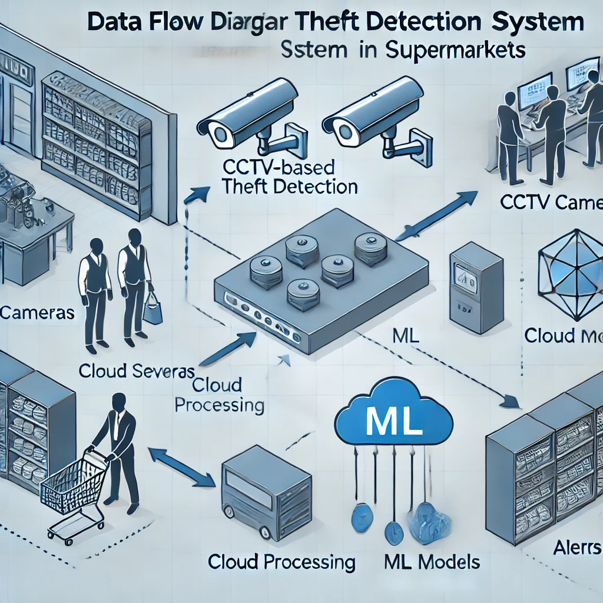
DATA FLOW DIAGRAM

Slide 23
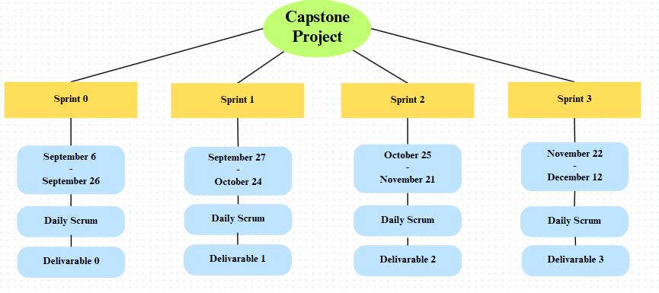
SCHEDULE

Slide 24
PRODUCT BACKLOG
User Story ID | Issue Type | User Story | Story Points
TA - 1 | Task | To gather all the requirements for the project. | 8
TA - 2 | Task | As a team we should have team work agreement with all rules and regulations. | 3
TA - 3 | Task | As a team we should divide roles and responsibilities among ourselves to develop the project. | 5
TA - 4 | Task | As a team we should develop required technical and functional knowledge required to complete the project. | 5
TA - 5 | Task | As a team we should plan the product requirements and development plan for the project. | 3
TA - 6 | User Story | As a user, I should be able to see the Knowledge page after the welcome page, which has information on how the application works. | 3
TA - 7 | User Story | As a user, I want to create my account for the application so that I can keep my account private and Signup Using my Name, Email, and Password. | 8
TA – 8 | User Story | As a user, I should be able to the user name and get registered in the application. | 3
TA – 9 | User Story | As a user, I want to log in using my user ID to access my account. | 5
TA - 10 | User Story | As a registered user I should be able to see the Main page, once I login into the application. | 5

Slide 25
PRODUCT BACKLOG
User Story ID | Issue Type | User Story | Story Points
TA – 11 | User Story | As a registered user I want to logout from the application so that I can log in again whenever I want. | 3
TA – 12 | User Story | As a user, I want to access the feature on the home page | 3
TA – 13 | User Story | As a user, I want to navigate between pages so that I can quickly access the features I need. | 5
TA – 14 | User Story | As a user, I want to upload fresh videos so I can watch them. | 8
TA - 15 | User Story | As a registered user, I want to see the option to change the user’s name in the settings page so that I can do so. | 3

Slide 26
SPRINT 1 BACKLOG
User Story ID | Issue Type | User Story | Story Points | Status
TA - 6 | User Story | As a user, I should be able to see the Knowledge page after the welcome page, which has information on how the application works. | 3 | Done
TA - 7 | User Story | As a user, I want to create my account for the application so that I can keep my account private and Signup Using my Name, Email, and Password. | 8 | Done
TA – 8 | User Story | As a user, I should be able to the user name and get registered in the application. | 3 | Done
TA – 9 | User Story | As a user, I want to log in using my user ID to access my account. | 5 | Done
TA - 10 | User Story | As a registered user I should be able to see the Main page, once I login into the application. | 5 | Done

Slide 27
ACCEPTANCE CRITERIA TABLE
User Story ID | User Story | Acceptance Criteria | Place
TA - 6 | As a user, I should be able to see the Knowledge page after the welcome page, which has information on how the application works. | Given I'm a user of the application When I try to install the application using the APK file Then I should be able to install the application without any errors. | Mobile
TA - 7 | As a user, I want to create my account for the application so that I can keep my account private and Signup Using my Name, Email, and Password. | Given I’m in the role of the user, trying to create my account to the application When I open the app Then the app asked me to sign up or log in, And I clicked on the signup, I was able to create my account for the application using my Name, Email, and Password. | Sign Up
TA – 8 | As a user, I should be able to the user name and get registered in the application. | Given I'm a user of the application When I enter my username in the registration page Then I should be able to click on the register button And get registered in the application. | Registration Page
TA – 9 | As a user, I want to log in using my user ID to access my account. | Given I’m the user of the application When I open the app, I should be able to see the app’s login page. Then I should be able to enter my registered User ID and my password in the password field. After entering my details, I should be able to Login. If my credentials are valid, I should be able to access my account | Log In
TA - 10 | As a registered user I should be able to see the Main page, once I login into the application. | Given I'm a user of the application When I completed the registration and gave all the required permissions Then I should be able to see the Main page And features of the application. | Main Page

Slide 28
TEST CASES
Test ID | User Story ID | User Story | Test Data | Steps to be taken | Expected Result | Actual Result
TT ID-1 | TA - 6 | As a user, I should be able to see the Knowledge page after the welcome page, which has information of how the application works. | Username: Vinod Password: Vinod@99 | When the User should be able to download the application from the Play Store/Appstore. | Application should be installed and display basic functionalities. | Application will be installed with basic functionalities without any errors.
TT ID-2 | TA - 7 | As a user, I want to create my account for the application so that I can keep my account private and Signup Using my Name, Email, and Password. | Username: Vinod Password: Vinod@99 | When the User clicks on the "Register" button then the user should be directed to the Registration page. | User should be on the Registration page. | User will be on the Registration page.
TT ID-3 | TA – 8 | As a user, I should be able to the user name and get registered in the application. | Username: Vinod Password: Vinod@99 | When the user clicks the submit button after entering a valid username, then the user should be registered in the application. | User should be registered successfully in the application. | User will be registered successfully in the application.

Slide 29
TEST CASES
Test ID | User Story ID | User Story | Test Data | Steps to be taken | Expected Result | Actual Result
TT ID-4 | TA - 9 | As a user, I want to log in using my user ID to access my account. | Username: Vinod Password: Vinod@99 | 1. When the user enters a valid User ID and password then the user can login into the application. 2. When the credentials given by user are invalid then the user will not be able to access to users account in the application. | User should be able to login into the application by giving valid credentials. | User will be logged into the application successfully.
TT ID-5 | TA - 10 | As a registered user I should be able to see the Main page, once I login into the application. | Username: Vinod Password: Vinod@99 | When the user enters their login credentials correctly then the user should be taken to the home page | User should be taken to the Main page successfully. | User will be taken to the Main page successfully.

Slide 30

METRICS

Slide 31
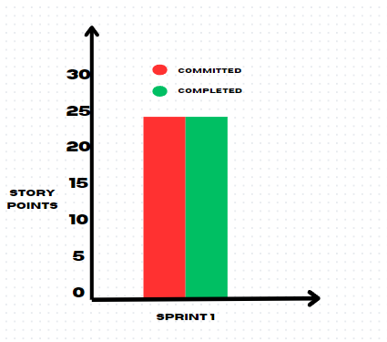

Team Velocity Chart

Slide 32
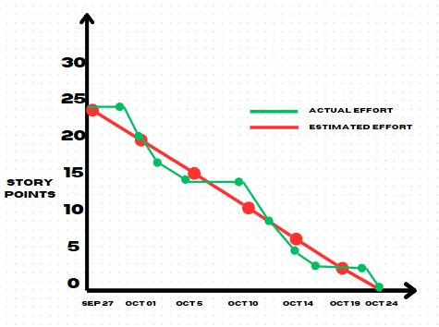

Burndown Charts
We committed to 24 story points and completed 24 story points.

Slide 33
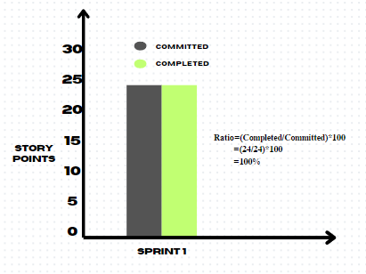

Completed/Committed Ratio
Sprint | Sprint 1
Committed | 24
Completed | 24
Ratio | 100%

Slide 34
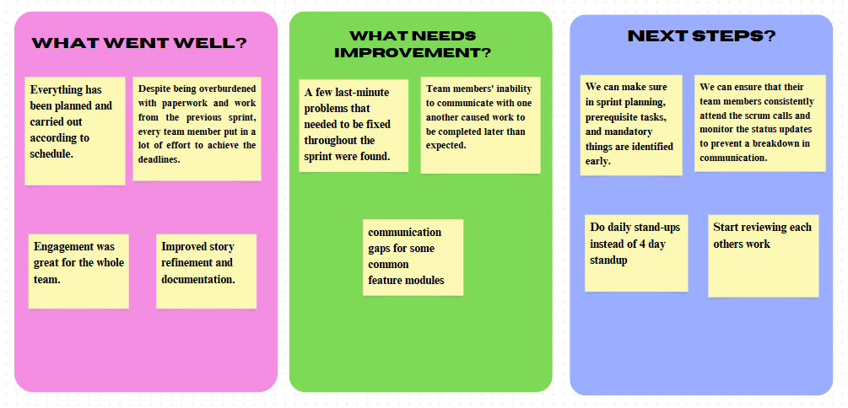
RETROSPECTIVE

Slide 35
SPRINT 2 BACKLOG
User Story ID | Issue Type | User Story | Story Points | Status
TA – 11 | User Story | As a registered user I want to logout from the application so that I can log in again whenever I want. | 3 | To Done
TA – 12 | User Story | As a user, I want to access the feature on the home page | 3 | To Done
TA – 13 | User Story | As a user, I want to navigate between pages so that I can quickly access the features I need. | 5 | To Done
TA – 14 | User Story | As a user, I want to upload fresh videos so I can watch them. | 8 | To Done
TA - 15 | User Story | As a registered user, I want to see the option to change the user’s name in the settings page so that I can do so. | 3 | To Done

Slide 36
APP LOGO

Slide 37

PROJECT DEMO

Slide 38
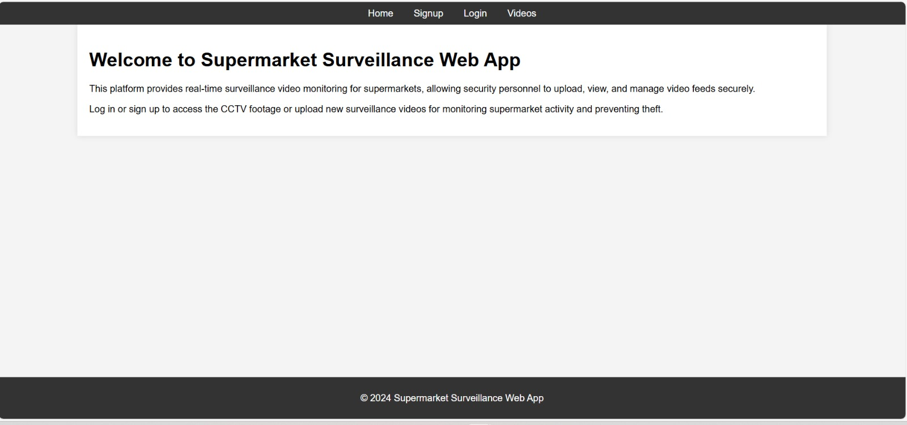
PROJECT DEMO SCREENSHOTS
Welcome Page

Slide 39
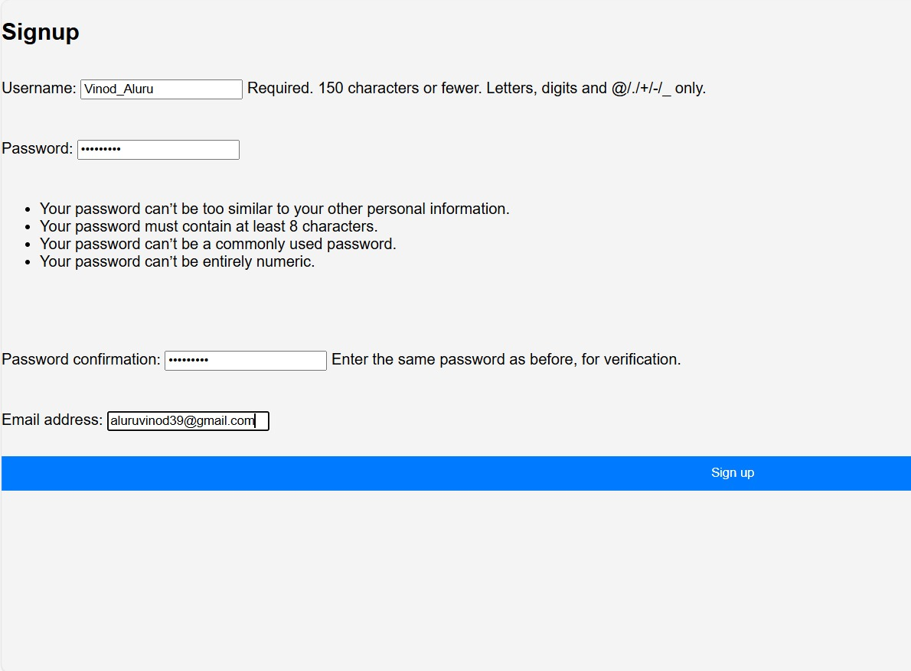
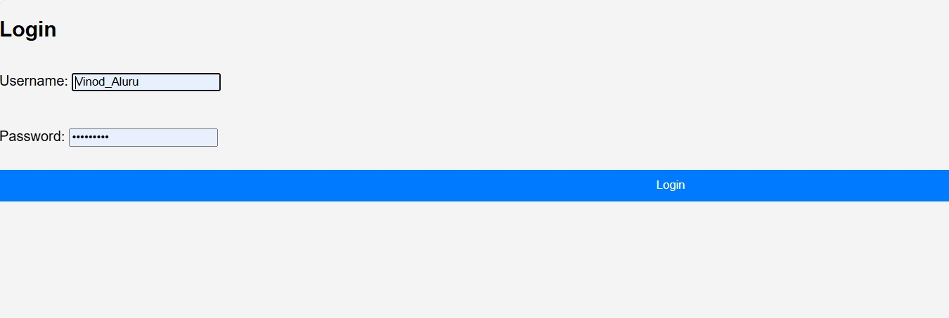
PROJECT DEMO SCREENSHOTS
Registration Page
Login Page

Slide 40
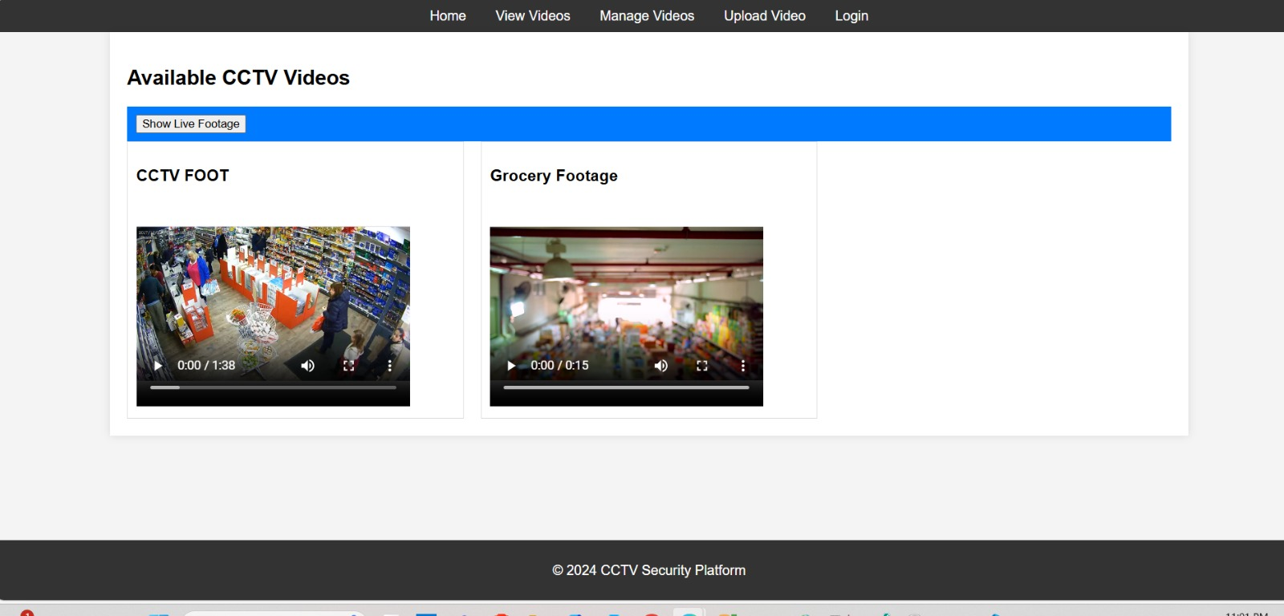
PROJECT DEMO SCREENSHOTS
Main View Videos Page

Slide 41


GITHUB LINK
https://github.com/htmw/2024F-Team4/wiki

Slide 42
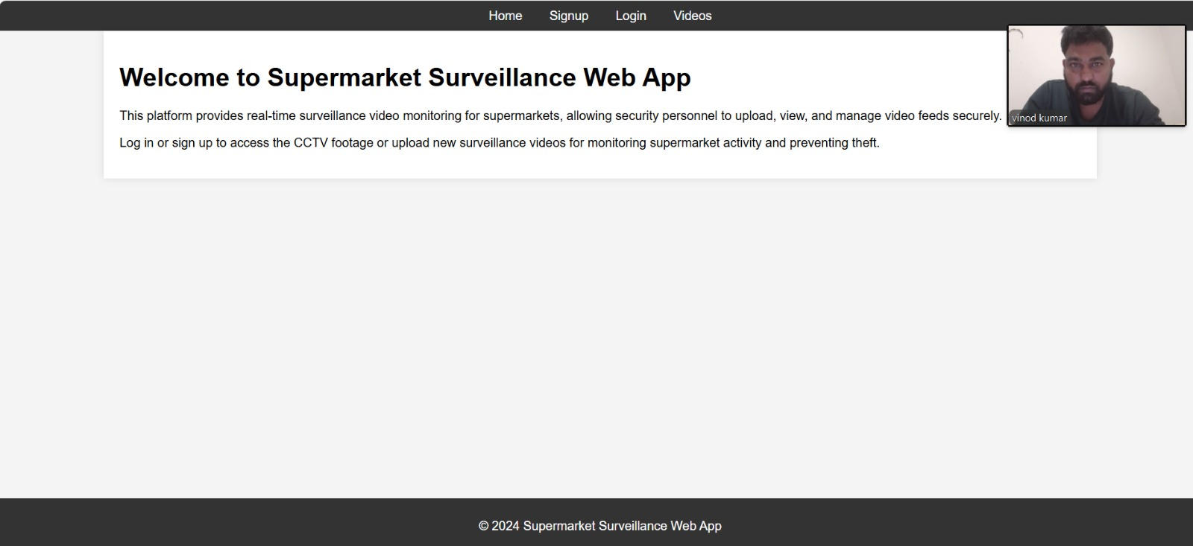
LIVE APPLICATION DEMO

Slide 43



